Slide 1
Pls 2000 power & politics DR. SHANNON
INTRO TO OUR COMPARATIVE COUNTRIES:
UK, ISRAEL, IRAN AND CHINA

Slide 2
RESEARCHING COUNTRIES
I. RESEARCHING COUNTRIES
II. INTRODUCING COUNTRIES
UK
ISRAEL
CHINA
IRAN
TERMS TO KNOW
None today (nothing testable)

Slide 3
i. RESEARCHING COUNTRIES
Your Dunbar Library: https://www.libraries.wright.edu/
Country research
https://guides.libraries.wright.edu/c.php?g=421754&p=2879454
https://www.cia.gov/the-world-factbook/countries/
Model UN page
https://guides.libraries.wright.edu/mun

Slide 4
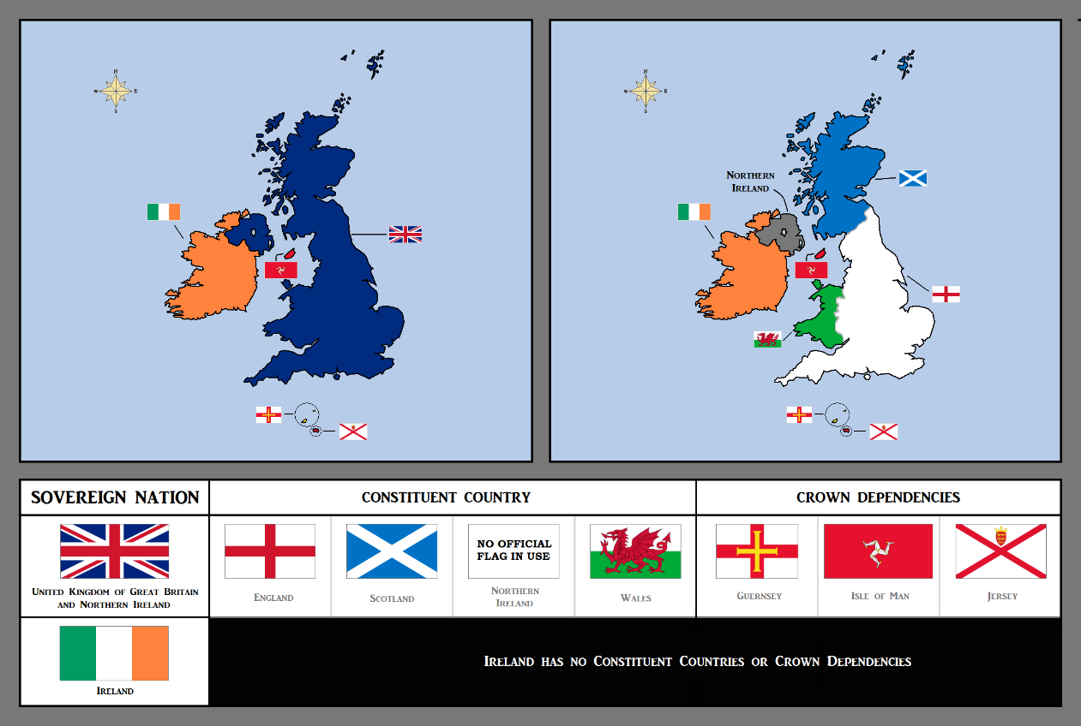
Iia. UNITED KINGDOM
Sources
Your syllabus reading: https://www.expatica.com/uk/living/gov-law-admin/british-government-103179/
Other sources:
https://www.gale.com/british-history
https://digital.library.lse.ac.uk/browse
http://smiccompgov.weebly.com/political-culture.html

Slide 5
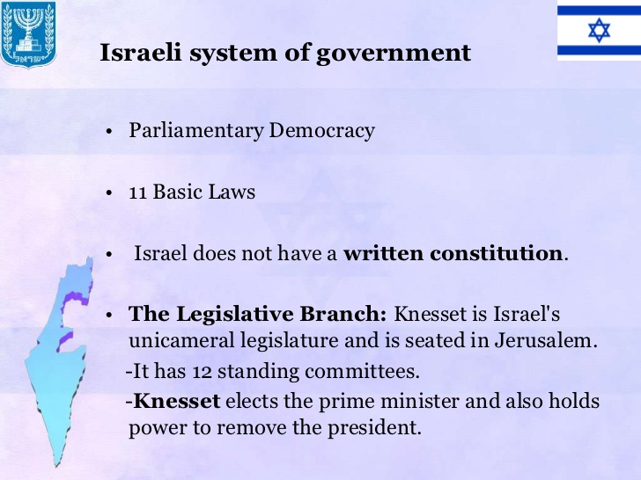
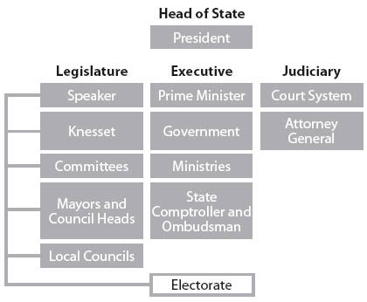
Iib. ISRAEL
Sources
Your Syllabus Reading: https://www.britannica.com/place/Israel/Government
Other Sources:
https://www.mfa.gov.il/mfa/aboutisrael/state/pages/the%20state-%20political%20structure.aspx
Jewish Virtual Library: https://www.jewishvirtuallibrary.org/israel
http://news.bbc.co.uk/2/shared/spl/hi/in_depth/china_politics/government/html/1.stm

Slide 6
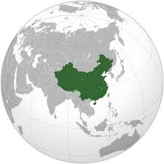
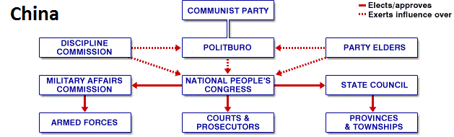
IIC. PEOPLE’S REPUBLIC OF CHINA
Sources:
Syllabus reading: https://www.bbc.co.uk/bitesize/guides/zptxxnb/revision/1
Other sources:
https://www.cfr.org/backgrounder/chinese-communist-party
https://www.nationsencyclopedia.com/economies/Asia-and-the-Pacific/China-POLITICS-GOVERNMENT-AND-TAXATION.html
https://www.fmprc.gov.cn/mfa_eng/

Slide 7
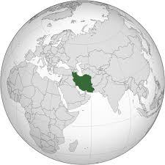
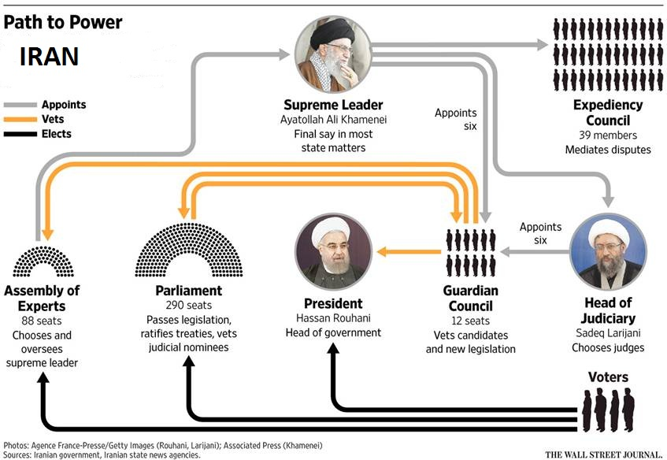
IID. IRAN
Sources:
Syllabus reading: https://www.cfr.org/backgrounder/religion-and-politics-iran
Other readings:
LOC: https://www.loc.gov/rr/frd/cs/pdf/CS_Iran.pdf
USIP: https://iranprimer.usip.org/index.php/

Slide 8
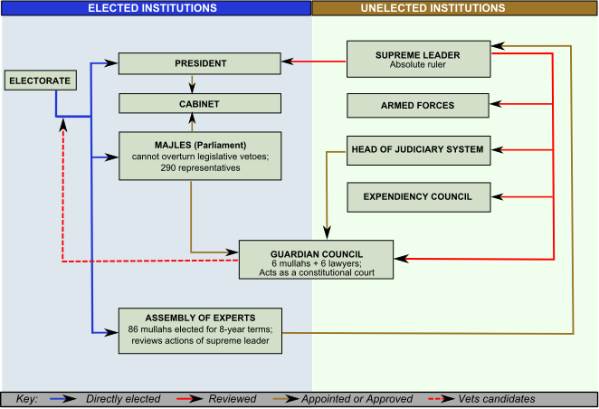
Iran’s Elected Institutions
PRESIDENT
Elected every 4 yrs (2 consecutive-term limited)
Must be “pious Shi’i faithful”
Chief Diplomat & Chief Executive
MAJLIS
Unicameral body of 290 seats elected to 4-year terms
ASSEMBLY OF EXPERTS
88 members elected for 8 yr. terms
Candidates are clerics and Islamic scholars
Elects, reelects, & removes Supreme Leader
http://www.pbs.org/wgbh/pages/frontline/tehranbureau/2011/09/women-struggle-in-parliament.html
http://en.iranwire.com/features/6362/

Slide 9
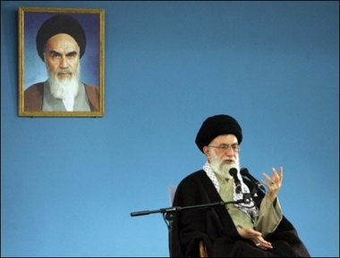
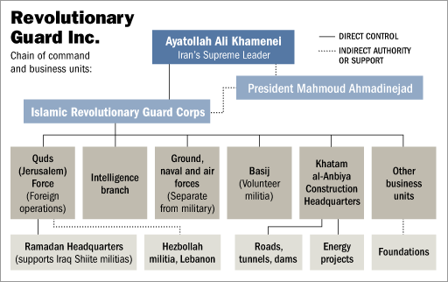
IRAN’S Unelected Institutions
Supreme Leader
Stand-in for Shia Hidden Imam
Ayatollah Khomeini ( -1989)
Ayatollah Khamenei (1989- )
Commander in chief
Islamic Revolutionary Guards Corps (IRGC)
Guardian Council
Vets candidates
Vetoes legislation
Expediency Council helps reconcile
Candidates Rejected for AoE | # Applicants | # Rejected | %
1982 | 168 | 22 | 13
1990 | 183 | 77 | 42
1998 | 396 | 250 | 63
2006 | 495 | 332 | 67
http://news.bbc.co.uk/1/shared/spl/hi/middle_east/03/iran_power/html/default.stm

